Slide 1
Group 8:
House Price in England & Wales
Amal Byju
Xin Wan
Yi Hua Huang

Slide 2
UK housing market background
UK Average House Price
2002: £106,406
2021: £273,000
Increased by 257%
UK Average Income
2002: £20,376
2021: £31,285
Increased by 154%

Slide 3
Data Set:
House Price Data, England & Wales
(Kaggle)
House price data from 2002 to 2021
Transaction information
Data size: 3GB
19 million rows of records
16 columns
Source:
https://www.kaggle.com/datasets/bkoohy/uk-house-price-paid-19952022

Slide 4
Business Questions
1. What are the different factors that affect house prices?
2. How house prices have changed over the years in different counties or cities of England and Wales?
3. How can we predict the price of a house given some input features?

Slide 5
Background
The UK House Price Index (HPI) uses house sales data from HM Land Registry, Registers of Scotland, and Land and Property Services Northern Ireland and is calculated by the Office for National Statistics.
We saw that house prices were increasing at a high rate so we wanted to investigate further.

Slide 6


Slide 7
Data Cleaning for SPARK
Removed columns containing NA (missing) values
Few columns contained abbreviations, so those values were replaced with full forms.
Removed columns that have discrepancies as the HM Land registrar changed the data collection procedure of these columns.
Removed a column that contained information which is specific to the data collection procedure of the HM Land Registrar since this is not required for our analysis.
We found that the Price column was right skewed, so we applied log transformation to get a normal distribution.
Converted the data type of ‘Date of Transfer’ column from character to date.

Slide 8
Stored the dataset in S3
Started an EMR instance
Wrote R script for data cleaning and analysis and ran it on the cluster.

Slide 9
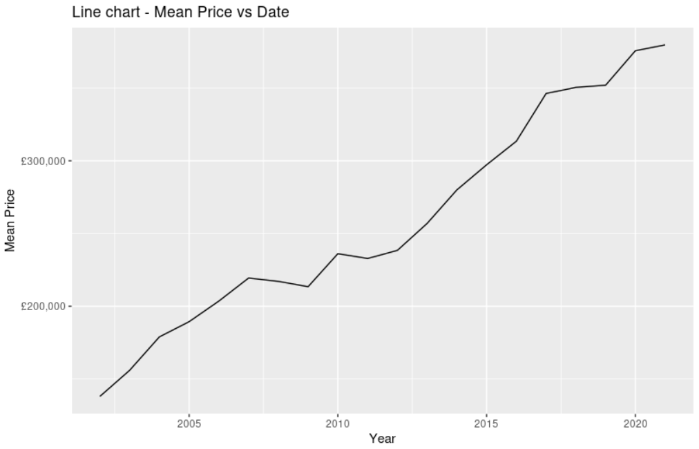
Descriptive Analysis

Slide 10
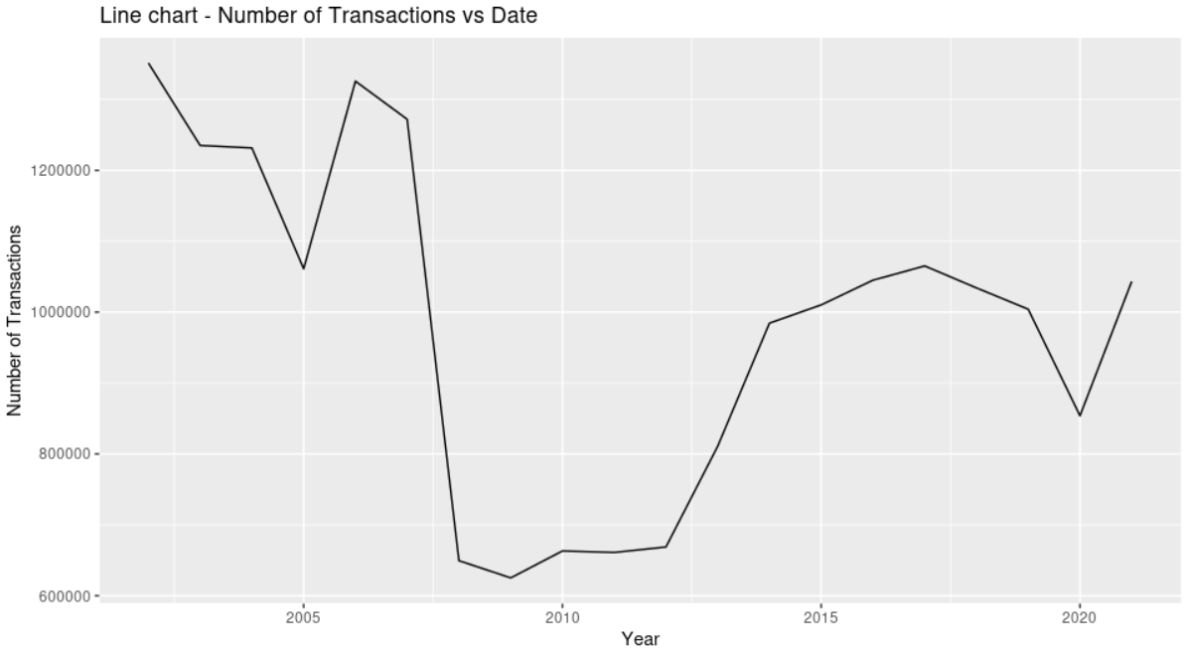
The steep decrease in demand corresponds to the Great Recession of 2008.

Slide 11
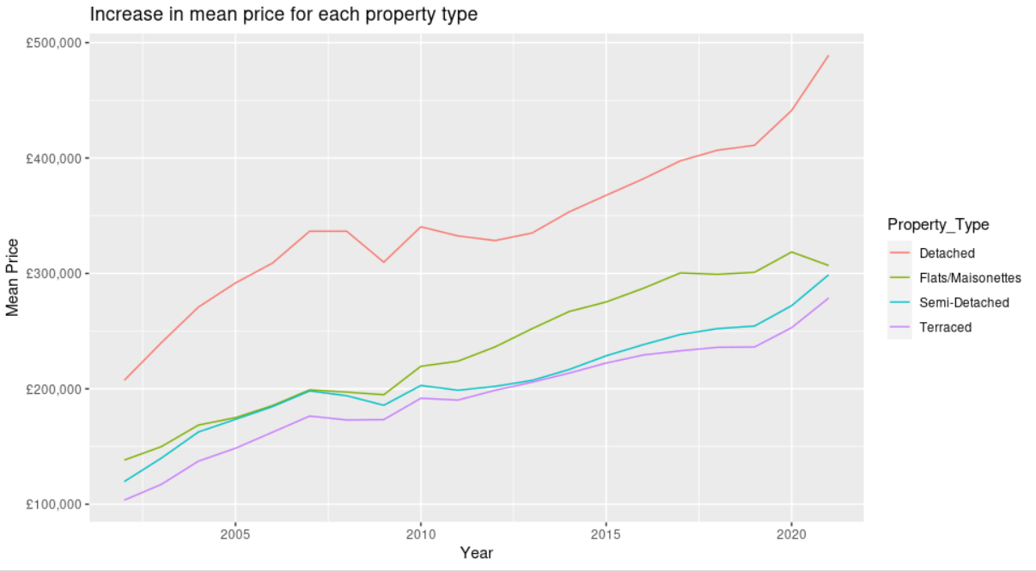
Detached houses are more expensive because of the larger space.
Terraced houses are usually more energy efficient and are cheap.

Slide 12
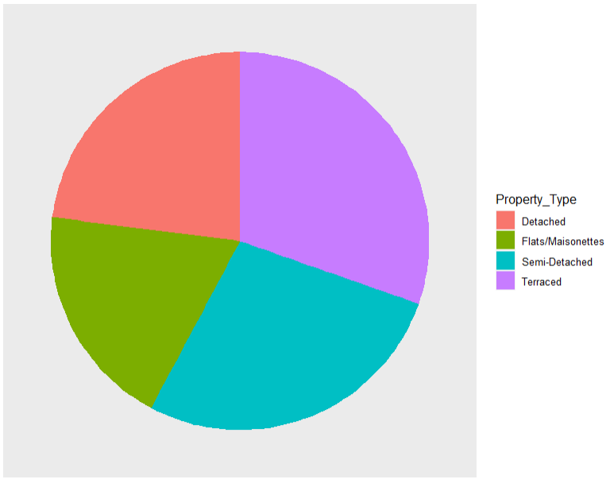
As expected, the number of transactions of terraced houses is the highest.
The number of transaction of detached properties is low because of its price.

Slide 13
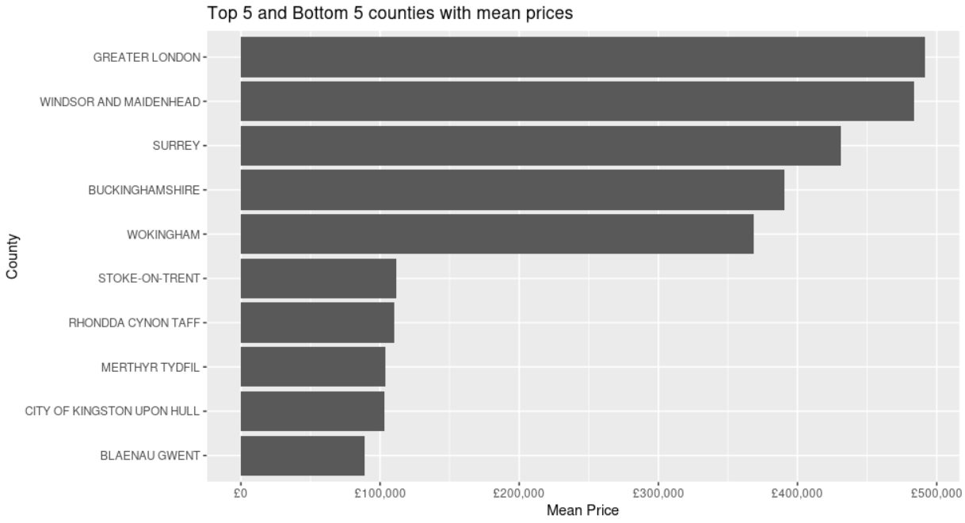
When we checked out the top 5 counties with highest average price, we found out that London had the highest value followed by counties in England that are close to it. Three out of the counties with the lowest prices are in Wales.

Slide 14
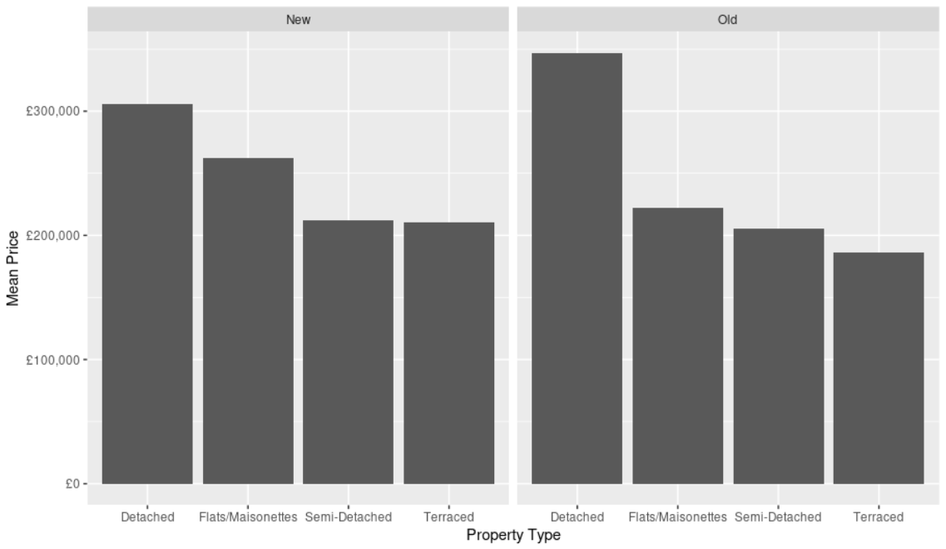
Here is the bar chart that shows the mean house price for each property type. On average, the prices of new properties are higher. However, it should be noted that the average house price of old detached houses is the highest.

Slide 15
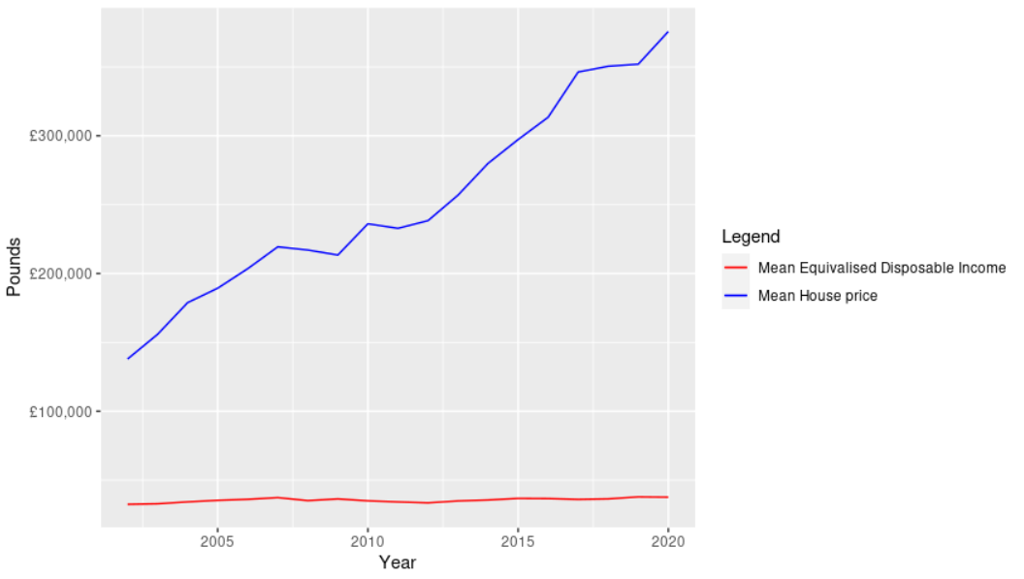
Business Question #2
How house prices have changed over the years in different counties of England and Wales. Moreover, we’ll be comparing mean house price to mean earnings over the years.
Houses have a low interest rate. So people buy them for investment. That is the reason why house price went up.
There are foreign investors too.

Slide 16
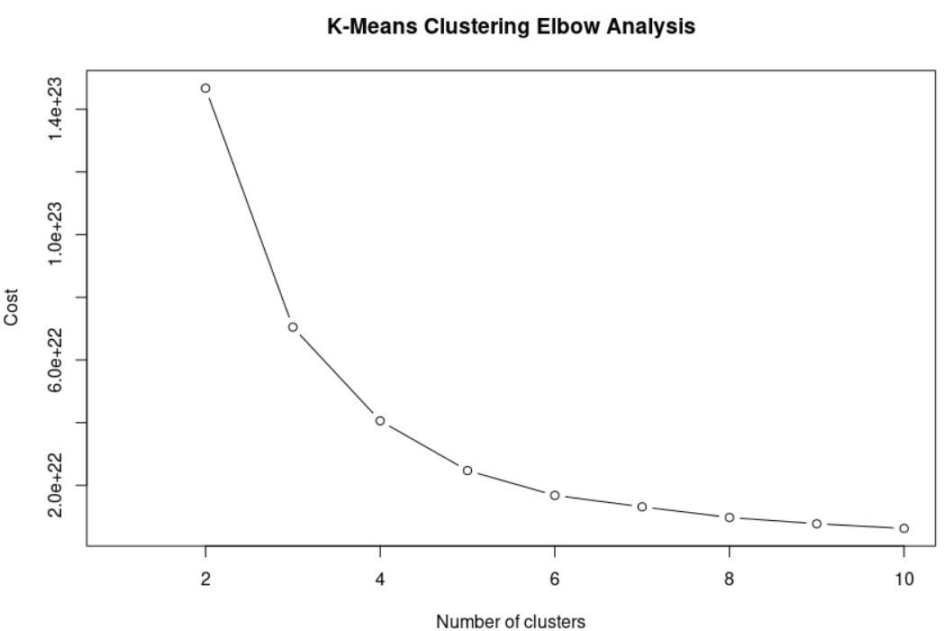
Analysis - K-Means Clustering
To find the optimum number of clusters, we used elbow analysis.
Since the elbow occurs at k = 3, we went ahead with 3 clusters.

Slide 17
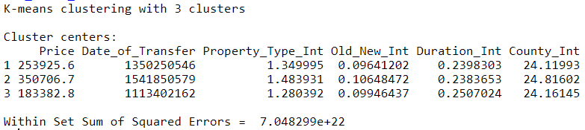
Results of K-Means
Features had to be coerced to numbers so some columns don’t make sense.
We can see that the Price (in pounds) is vastly different in the 3 clusters.

Slide 18
Predictive Models
Business Question #3
Predict the price of a house given some input features.
As the RMSEs of the models are lesser than the standard deviation of log(Price) in the test dataset, both models perform better than just predicting the average log(Price) for every observation.
Gradient Boosted Tree is the better model with lower test RMSE.
 | RMSE on test dataset | Standard deviation of log(Price) in test dataset
Random Forest | 0.617 | 0.734
Gradient Boosted Tree | 0.520 | 0.734

Slide 19
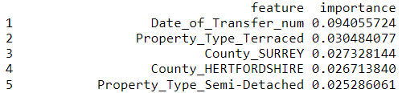
Business Question #1
What are the different factors that affect house price?
Feature Importance
Features that are important are Date_of_Transfer, County, Property_Type.
These features are important according to the GBT model.

Slide 20
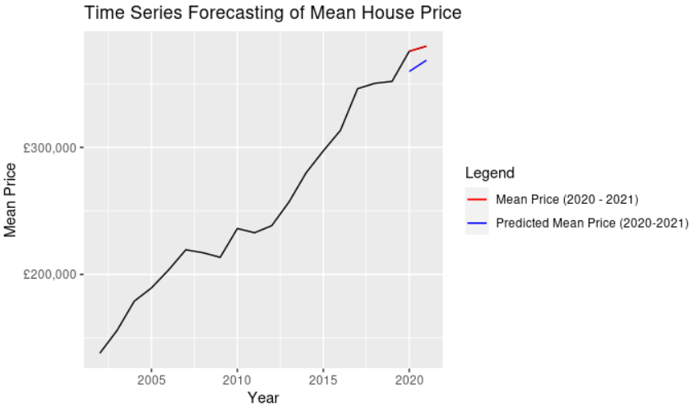
Time Series Forecasting
We used tbats model to forecast average house prices for 2020 and 2021. The blue line represents the forecast and the red line represents the actual house prices.

Slide 21
Further Analysis with Impala

Slide 22
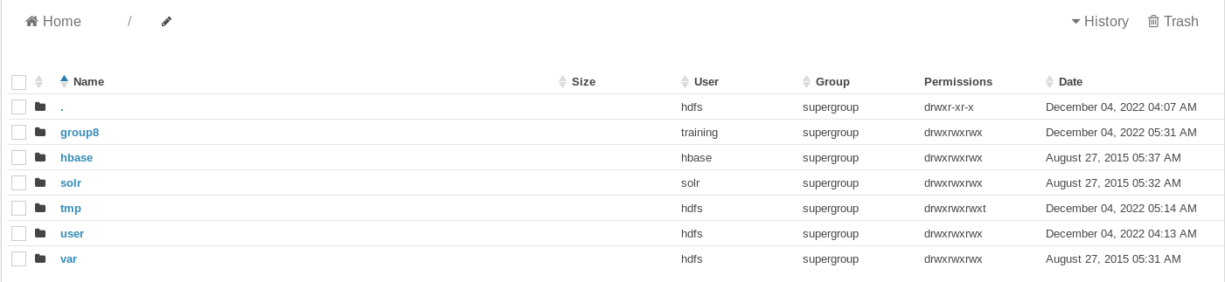
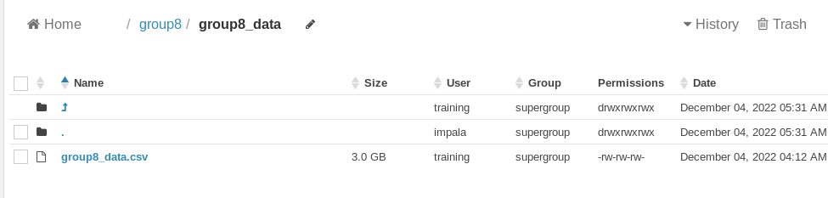
Create a new directory, and store our dataset in the directory

Slide 23
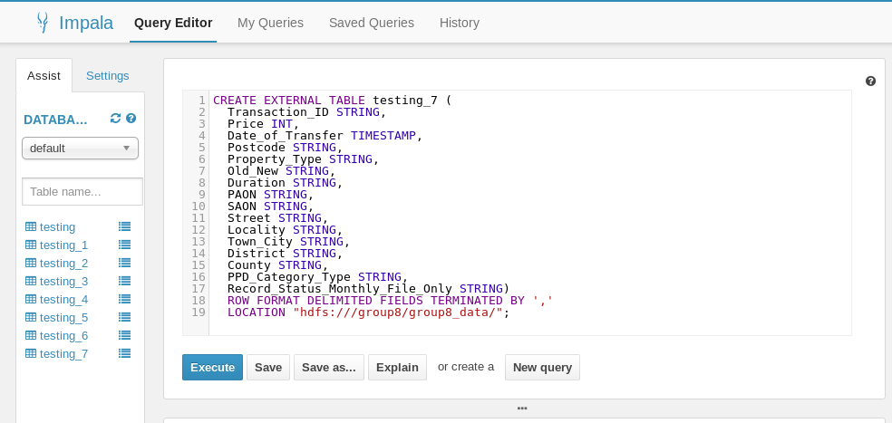

Slide 24
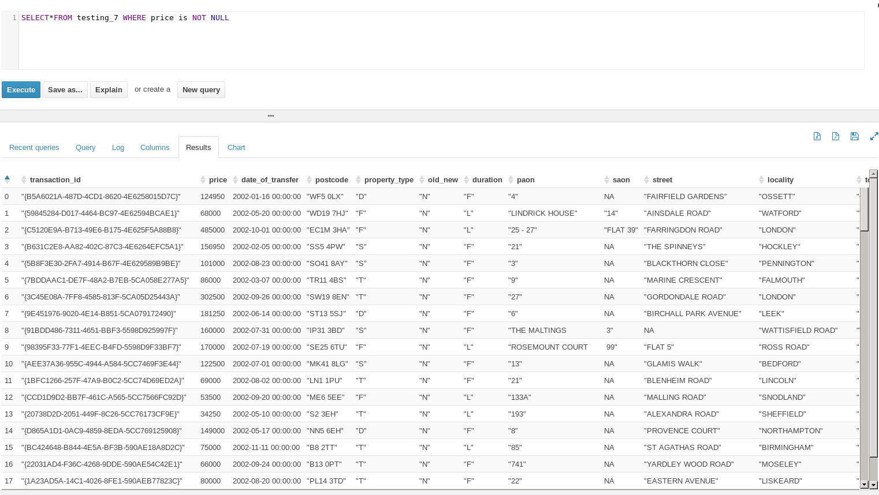

Slide 25
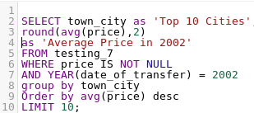
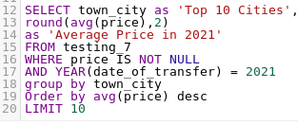
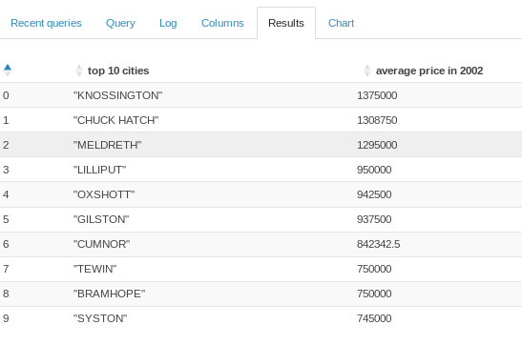
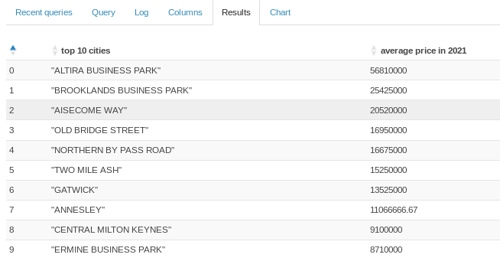
Notes:
-30 mins, 1-2 hours, over 2 hours to london
-nearby london 1-2 hours drive

Slide 26
Top 10 cities in 2002 VS Top 10 cities in 2021
Top 10 cities in 2002. Their distance with London are various.
Most Top 10 cities in 2021 are 1-2 hours drive.
There was net economic growth of £600 million to the visitor economy during London Olympic.
People rely on London more.
Notes:
Top 10 cities in 2002. Their distance with London 2002 are various. However, Most Top 10 cities in 2021 are 1-12 hours.
Because of London Olypmic, London economy grow about 6 hundred million during the game.
People rely on London more to get the proper so they live nearby the city.

Slide 27
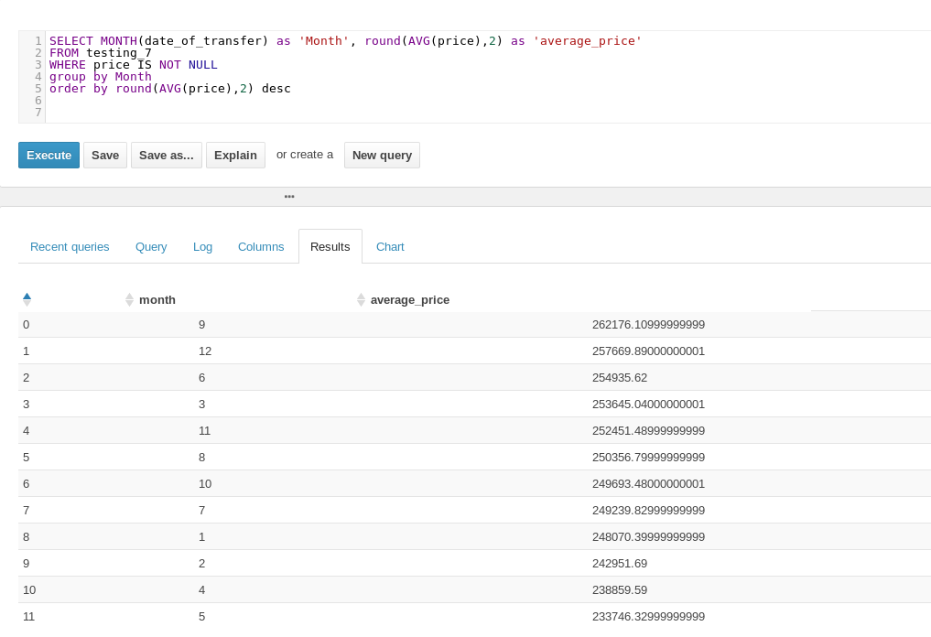
Notes:
Why house price higher in Sep?
-This sharp rise is due to the stamp duty holiday which the UK Government announced last year and which ended on 30 September 2021. buyers of homes valued at up to £500,000 will no longer pay any stamp duty on the purchase.
The stamp duty is the certain taye that need to pay when buying the house.

Slide 28
Conclusion
Cities and counties close to London have higher average house price because there might be commuters who live in these regions but work in London, earning London wages (which are higher).
Detached houses are more expensive whereas terraced houses are cheap. This is probably the reason why the demand for detached houses is higher than that of terraced houses.
The trend of mean house price is much steeper than that of income. This is because houses have a low interest rate. So people buy them for investment. Moreover, there are foreign investors.

Slide 29
Business Impact of the Analysis
The Gradient Boosted Tree might be useful to predict the price of a house, which might be useful to property owners.
Since the HM Land Registrar and the government would be interested in average house price forecasts in the coming years, we trained a time series model and used it to forecast average house price in 2020 and 2021. The RMSE is 13712.74.
Moreover, our explanatory analysis using Spark and Impala might be a useful source of information for the government, the HM Land Registrar and the housing market.

Slide 30
THANK YOU!

